Slide 1
Procedure calls and Buffer Overflows
ENPM 691 – Secure Programming in C

Slide 2
References
Computer Systems programmer’s perspective
Chapter 3 on Procedures
Secure Coding in C and C++
Chapters 2 and 3
Hacking – The art of exploitation
Chapter 3 on Buffer Overflows
http://www.shell-storm.org/shellcode/
Archive of shellcode
The Shellcoders Handbook (2nd Edition)
Chapters 1, 2, and 3

Slide 3
Structure of the Stack – Before Call
High Memory
int add(int x, int y)
{
int z;
z = x + y;
return z;
}
main()
{
int ans= add(1, 2);
write();
}
ESP
Low Memory

Slide 4
Push Arguments of called function
High Memory
int add(int x, int y)
{
int z;
z = x + y;
return z;
}
main()
{
int ans= add(1, 2);
write();
}
2
1
ESP
Low Memory

Slide 5
Push Return Address
High Memory
int add(int x, int y)
{
int z;
z = x + y;
return z;
}
main()
{
int ans = add(1, 2);
write();
}
2
1
ret
ESP
z
Low Memory

Slide 6
Inside the callee (i.e. add function)
High Memory
int add(int x, int y)
{
int z;
z = x + y;
return z;
}
main()
{
int ans = add(1, 2);
write();
}
2
1
ret
EBP - Old
New EBP
ESP
Low Memory

Slide 7
Inside the callee – push local vars
High Memory
int add(int x, int y)
{
int z;
z = x + y;
return z;
}
main()
{
int ans = add(1, 2);
write();
}
2
1
ret
EBP - Old
New EBP
int z
Low Memory
ESP

Slide 8
Inside the callee – reset the esp to ebp
High Memory
int add(int x, int y)
{
int z;
z = x + y;
return z;
}
main()
{
int ans = add(1, 2);
write();
}
2
1
ret
EBP - Old
New EBP
ESP
z
Low Memory

Slide 9
Inside the callee – pop the old ebp
High Memory
int add(int x, int y)
{
int z;
z = x + y;
return z;
}
main()
{
int ans = add(1, 2);
write();
}
2
1
ret
ESP
z
Low Memory

Slide 10
After the returning from add
High Memory
int add(int x, int y)
{
int z;
z = x + y;
return z;
}
main()
{
int ans = add(1, 2);
write();
}
2
1
ESP
z
Low Memory

Slide 11
Caller removes the parameters
High Memory
int add(int x, int y)
{
int z;
z = x + y;
return z;
}
main()
{
int ans = add(1, 2);
write();
}
ESP
z
Low Memory

Slide 12
Referencing Data Using EBP
High Memory
2
12(%EBP)
1
8(%EBP)
ret
4(%EBP)
EBP - Old
%EBP
z
-4(%EBP)
ESP
Low Memory

Slide 13
Stack-based Buffer overflow
A buffer overflow is an anomaly where a program, while writing data to a buffer, overruns the buffer's boundary and overwrites adjacent memory
Buffer overflows can be triggered by inputs that are designed to execute code, or alter the way the program operates

Slide 14
Stack-based Buffer Overflow
By overwriting the return address in a stack frame. Once the function returns, execution will resume at the return address as specified by the attacker, usually a user input filled buffer.
By overwriting a local variable that is near the buffer in memory on the stack to change the behavior of the program which may benefit the attacker.
By overwriting a function pointer, or exception handler, which is subsequently executed

Slide 15
Stack Layout
High Memory
Arg 2
12(%EBP)
Arg 1
8(%EBP)
ret
4(%EBP)
EBP - Old
%EBP
Local var
-4(%EBP)
ESP
Low Memory

Slide 16
Stack Layout – inside getData
void getData()
{
char buffer[4];
gets(buffer);
puts(buffer);
}
main()
{
getData();
return 0;
}
High Memory
ret
4 bytes
EBP - Old
4 bytes
Local buffer
(4 bytes)
4 bytes
&buffer
ESP
Low Memory

Slide 17
Stack Layout – How to Crash?
Need to fill up first 8 bytes after the buffer
We will be in RET
Need to fill up the next 4 bytes to modify the RET
EIP address is now pointing to a new address!
Old RET address is gone!
After getData is executed, the control will not return to the caller (i.e., main)

Slide 18
Demo Time

Slide 19
Example
#include <unistd.h>
#include<stdio.h>
void Test()
{
char buff[4];
gets(buff);
puts(buff);
}
int main(int argc, char *argv[ ])
{
Test();
return 0;
}
gcc –ggdb –o test_buff test_buff.c -fno-stack-protector
-mpreferred-stack-boundary=2

Slide 20
Demo Setup
Put a breakpoint after calling “gets”
Input Data for “gets”: TEST-EBP-RET
“TEST” goes to the buffer (4 bytes)
“-EBP” overrides the old EBP (4 bytes)
“-RET” overrides the return address (4 bytes)
X/4xb $ebp
-, E, B, P
Return address: X/4xb $ebp+4
-, R, E, T
$ebp, $ebp+4 are corrupted right after “gets”

Slide 21
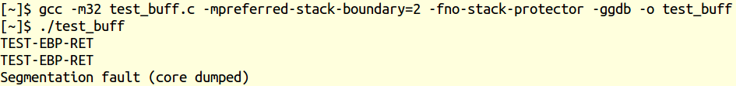
Denial of Service
Why did the program crash?

Slide 22
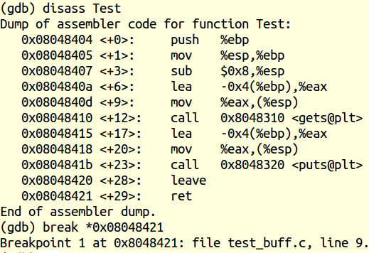
Investigation using gdb
Put a breakpoint at the “ret” instruction of the Test function

Slide 23
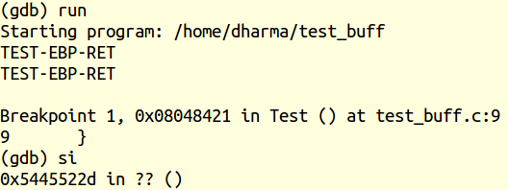
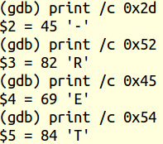
Investigation using gdb
Run the program with TEST-EBP-RET as the input to “gets”
Return address got corrupted

Slide 24
Stack during the function call
High Memory
EBP+8
ret
EBP+4
EBP - Old
EBP
EBP-4
[3]
[2]
[1]
[0]
Low Memory

Slide 25
Stack during the function call
High Memory
EBP+8
ret
EBP+4
EBP - Old
The user input is “AAA”
x/x $ebp-4: 0x00414141
(41 = A in hex)
x/s $ebp-4: “AAA”
EBP
EBP-4
\0
A
A
A
Low Memory

Slide 26
Stack during the function call
High Memory
The user input is “AAAAA”
x/x $ebp-4: 0x41414141
(41 = A in hex)
x/x $ebp (in my machine):0xbfff 0041
x/s $ebp: A
x/x $ebp-4:AAAAA
EBP+8
ret
EBP+4
EBP
bf
ff
\0
A
EBP-4
A
A
A
A
EBP of the caller is partly corrupted!
ESP
Low Memory

Slide 27
Stack during the function call
High Memory
The user input is “AAAAAAAA”
x/x $ebp-4: 0x41414141
(41 = A in hex)
x/x $ebp: 0x41414141
x/s $ebp:AAAA
x/x $ebp+4 (in my machine):0x08048400
EBP+8
EBP+4
08
04
84
\0
EBP
A
A
A
A
EBP-4
A
A
A
A
EBP and parts of the
return address of the caller are corrupted!
ESP
Low Memory

Slide 28
Stack during the function call
High Memory
The user input is “AAAAAAAAAAAA”
x/x $ebp-4: 0x41414141
(41 = A in hex)
x/x $ebp: 0x41414141
x/x $ebp+4 :0x41414141
x/x $ebp+8 : 0x…00
EBP+8
\0
EBP+4
A
A
A
A
EBP
A
A
A
A
EBP-4
A
A
A
A
EBP and the return address of the caller are corrupted!
ESP
Low Memory

Slide 29
Tricking the Return Address!
void deadCode()
{
printf(“I’m alive!”);
exit(0);
}
void getData()
{
char buffer[4];
gets(buffer);
puts(buffer);
}
Can we activate the deadCode by smashing the stack?
Note: Add –zexecstack option to gcc

Slide 30
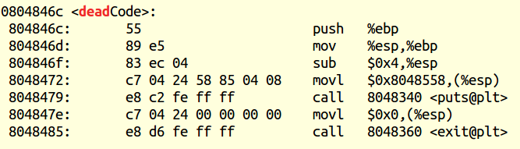

Tricking the Return Address!
First 4 bytes for our input buffer
Next 4 bytes to override the ebp register
Last 4 bytes point to the deadCode function

Slide 31
Stack-based Buffer Overflow
By overwriting the return address in a stack frame. Once the function returns, execution will resume at the return address as specified by the attacker, usually a user input filled buffer.
By overwriting a local variable that is near the buffer in memory on the stack to change the behavior of the program which may benefit the attacker.
By overwriting a function pointer, or exception handler, which is subsequently executed

Slide 32
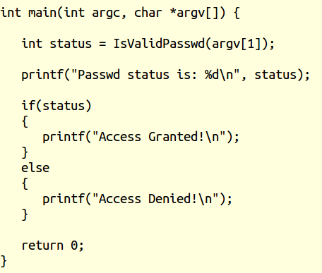
Goodbye passwd demo

Slide 33
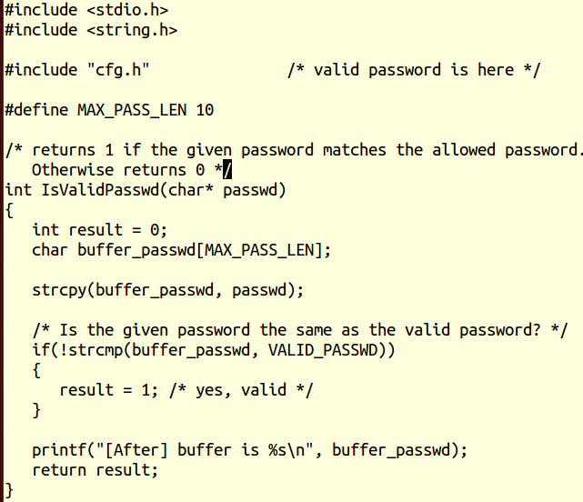
Goodbye passwd demo
We don’t know
VALID_PASSWD
Can we trick this
function to return a non-zero value?

Slide 34

Goodbye passwd demo
Give A 11 times as the input password
strcpy will overflow
Local variable result will be overridden by ‘A’
Return code will be non-zero!

Slide 35
Stack-based Buffer Overflow
By overwriting the return address in a stack frame. Once the function returns, execution will resume at the return address as specified by the attacker, usually a user input filled buffer.
By overwriting a local variable that is near the buffer in memory on the stack to change the behavior of the program which may benefit the attacker.
By overwriting a function pointer, or exception handler, which is subsequently executed

Slide 36
Stack Layout – inside getData
void getData()
{
char buffer[8];
gets(buffer);
puts(buffer);
}
High Memory
ret
4 bytes
EBP - Old
4 bytes
Local buffer
(8 bytes)
8 bytes
ESP
First 8 bytes for our input buffer
Next 4 bytes to override the old ebp
Last 4 bytes to override the ret address
Low Memory

Slide 37
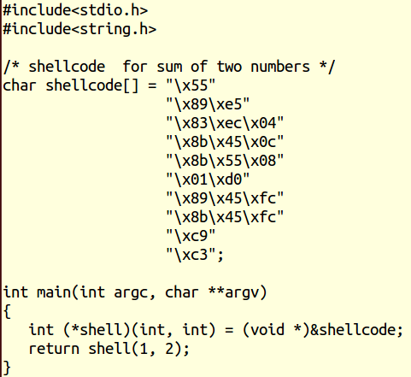
Shellcode for adding two numbers?
Note: pass –z execstack option to gcc to allow executable stacks

Slide 38
ShellCode Injection
Redirecting the ret address to machine code!
Shellcode: Usually a shell is spawned at runtime
Take control of a hacked machine/program

Slide 39
ShellCode Injection - Steps
Write C code to run after hacking
Convert C code into executable
Disassemble machine code from executable
Place the machine code address into ret
Ret is corrupted now!
Hacked program will now transfer to our shellcode

Slide 40
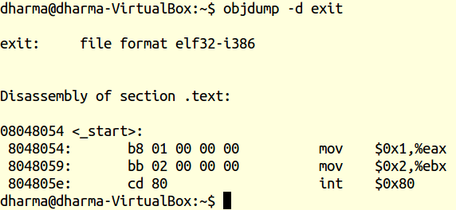
Preparing a shellcode
exit(2)
Extracted the machine code using objdump

Slide 41
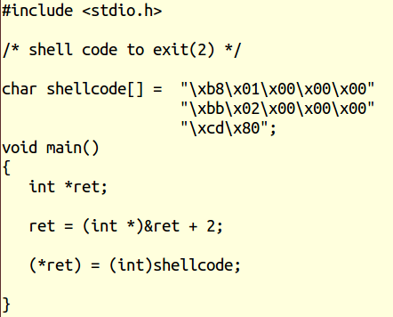
Injecting a shellcode
Machine code of exit(2)
&ret + 2 points to the ret of caller
./main
echo $?
Output: 2
main is called by libc_main
we tricked the return to our shellcode

Slide 42
Stack Layout – Inside Main
High Memory
EBP+4
Ret
(libc main)
4 bytes
EBP
EBP – Old
(libc main)
4 bytes
Local var
(ret ptr = null)
4 bytes
ESP
Low Memory

Slide 43
Stack Layout – Inside Main
High Memory
&ret = EBP-4
&ret + 2 = EBP+4
ret = &ret + 2
EBP+4
Ret
(libc main)
EBP
EBP – Old
(libc main)
ret =
EBP + 4
ESP
Low Memory

Slide 44
Stack Layout – Inside Main
High Memory
*ret = shellcode
Ret address of main is overridden
EBP+4
shellcode
EBP
EBP – Old
(libc main)
ret =
EBP + 4
ESP
Low Memory

Slide 45
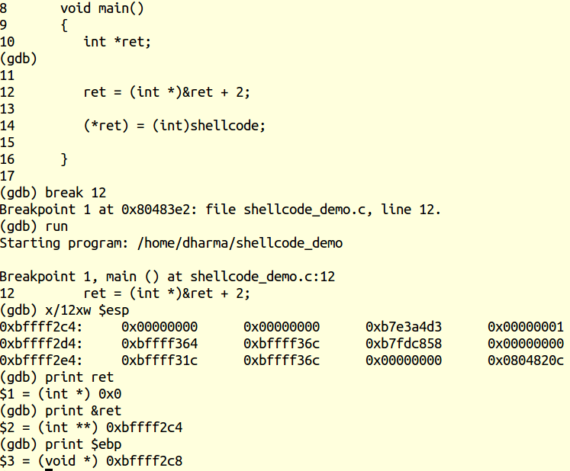

Slide 46

How/why the shellcode worked?
Top of the stack points to the local var ret
See print &ret same as $esp
0xb7e3a4d3 is the return address (libc main)
After ret = &ret + 2
oxbffff2cc = oxbffff2c4 + 8

Slide 47
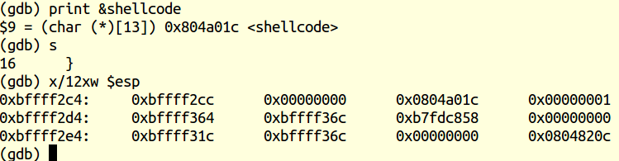
Overriding the libc main address
(libc) 0xb7e3a4d3 is replaced by 0x0804a01c
0x804a0lc contains our shellcode

Slide 48
Summary
strcpy and gets function do not check for size bounds
Be careful when you use these functions
Pointer arithmetic could override memory address
An attacker can construct shellcode to take over vulnerable program/machine
Try these types of analysis at home

